Slide 1
Файловый ввод/вывод
Практическое применение
ООПиРИС
Веревкин С.А.

Slide 2
Классы по работе с файлами
Информационные
  Path
  DirectoryInfo
  DriveInfo
  FileInfo
по работе с файловой системой
  Directory
  File
вспомогательные
  BinaryReader/BinaryWriter
  BufferedStream
  FileStream
  MemoryStream
  StreamReader/StreamWriter
  StringReader/StringWriter

Slide 3

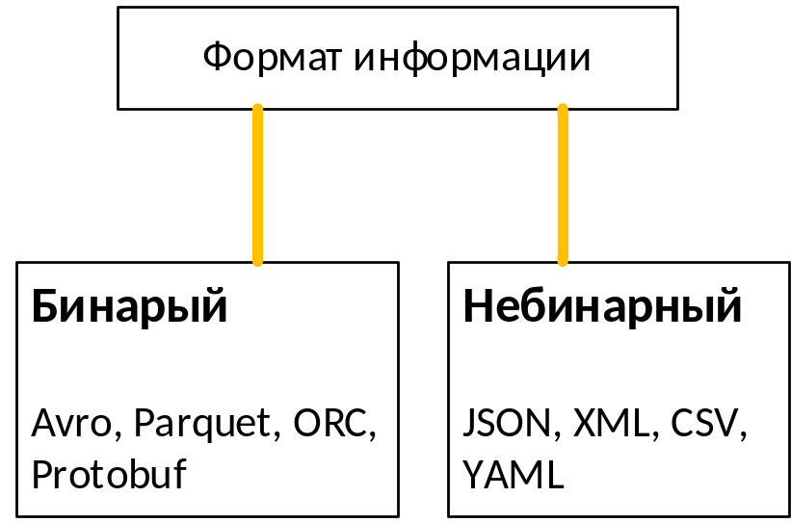
Форматы хранения

Slide 4
Форматы хранения
бинарные форматы
Binary formats are machine-readable
Binary formats are scalable and Preferred for distributed systems.
Binary formats can be split across multiple disks or servers
Binary formats are used if data, messages need to be exchanged between two or more services
небинарные форматы
Non-binary Formats are human-readable.
Non-binary formats are limited scope in Big Data\Hadoop systems due to limits in terms of their Scalability and Parallelism.
Non-binary format can’t be split.
non-binary formats are used if data, messages need to be exchanged between browsers or tools.

Slide 5
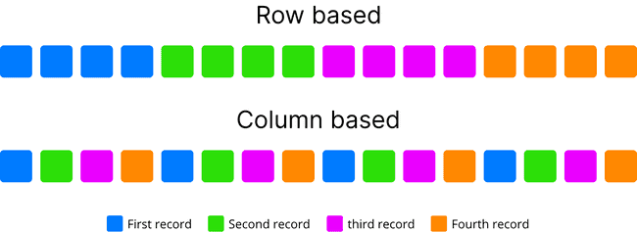
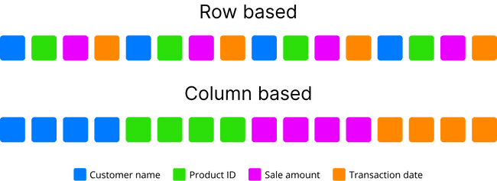
Форматы хранения
Parquet, ORC :
Stores data in columns oriented.
Good for analytical read-heavy applications. Parquet is very much used in spark applications. whereas ORC is heavily used in Hive.
Avro & Protobuf :
Stores data in rows.
Good for write-heavy applications like transaction systems. Very adoptive for Schema Evolution. Used for Kafka messages.
JSON :
It is used for Browser-based applications.
JSON is quicker to read and write. It is extended from JavaScript.
XML :
XML data is in a string format.
XML file is larger. If we want to represent the data in XML then it would create a larger file as compared to JSON. XML data is represented in tags, i.e., start tag and end tag.
Example grouping records by color
Example grouping properties by color

Slide 6
Форматы хранения
Types | CSV | JSON | XML | AVRO | Protocol Buffers | Parquet | ORC
text versus binary | text | text | text | metadata in JSON, data in binary | text | binary | binary
Data type | no | yes | no | yes | yes | yes | yes
Schema enforcement | no (minimal with header) | external for validation | external for validation | yes | yes | yes | yes
Schema evolution | no | yes | yes | yes | no | yes | no
Storage type | row | row | row | row | row | column | column
OLAP/OLTP | OLTP | OLTP | OLTP | OLTP | OLTP | OLAP | OLAP
Splittable | yes in its simpliest form | yes with JSON lines | no | yes | no | yes | yes
Compression | yes | yes | yes | yes | yes | yes | yes
Batch | yes | yes | yes | yes | yes | yes | yes
Stream | yes | yes | no | yes | yes | no | no
Typed data | no | no | no | no | yes | no | no
Ecosystems | popular everywhere for its simplicity | API and web | enterprise | Big Data and Streaming | RPC and Kubernetes | Big Data and BI | Big Data and BI

Slide 7
Работа с XML
DOM – Document object model
SAX – Simple API XML
Сериализация

Slide 8
JSON
Сериализация

Slide 9
Спасибо за внимание

